Slide 1
Traffic data analysis
By Caroline Woto

Slide 2
Introduction
Traffic crashes are a major threat to public safety because they often cause injuries,
deaths, and financial losses.
Knowing the main reasons for these events, when they happen most often,
and the groups of people who are most affected can help one to come up with good safety measures.
This project will take a look at what causes accidents, how often they happen by month and day, and
how gender affects accident rates and injuries.
Traffic accidents may arise from a confluence of human error, environmental variables,
and vehicle-related causes. According to published data, prevalent contributory factors of accidents include:
Speeding: exceeding the speed limit will shortens reaction time thus one is more prone to accidents
Distraction : A driver is likely distratected by use of phone while driving ,altering in car entertainment can also be a
Major cause of accident
Disregards of traffic lights especially at intersections
Driving under the influence of alcohol
Weather condition , rain, snow and fog usually increases the risk of collision
Wreckless driving is another cause of accidents
I will use the data on kaggel . https://www.kaggle.com/datasets/isadoraamorim/trafficcrasheschicago\

Slide 3
Objectives
The main objective of this study is to understand the pattern of these accidents .i.e when and how they occur .
The finding for this projects can be used by other scholars to deepen their understanding in data analysis

Slide 4
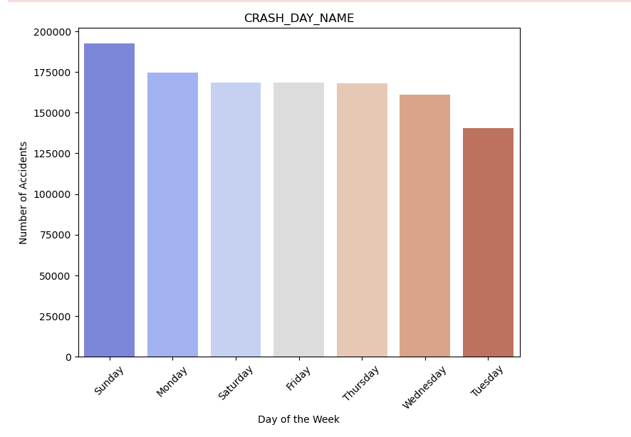
Data Analysis –Days of the Week
Understanding when the accidents occur is key as this will inform the
Government when they need to deploy police on the road / implement new traffic laws /run road safety campaigns
Holidays and long weekends often record a surge in accident rates due to higher traffic volumes and impaired driving

Slide 5
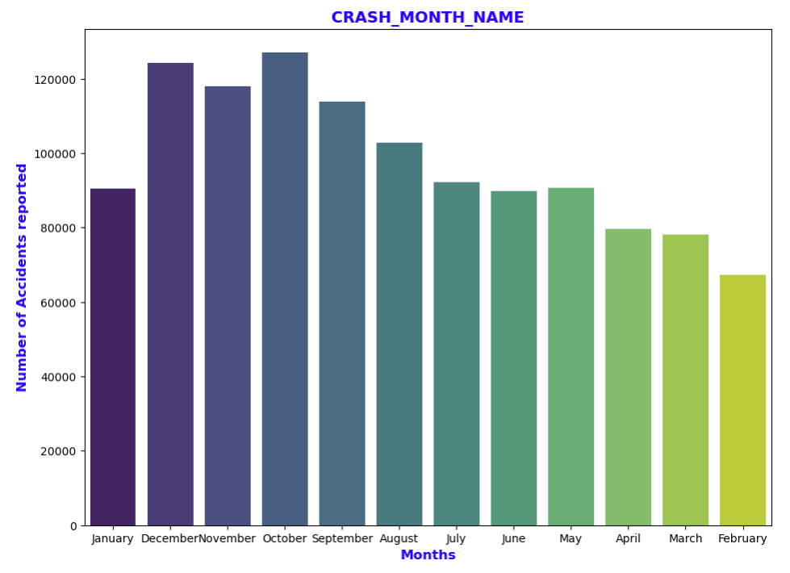
Data Analysis_Crash Month
A deeper look at the monthly trend shows that surge in number of accidents during the last quarter of the year . This can be due to increased travel and recreational activities.
Winter months (December to February) also show a spike in accidents, particularly in regions experiencing snowfall and icy conditions.
October and November often see an increase due to shorter daylight hours and unpredictable weather changes.

Slide 6
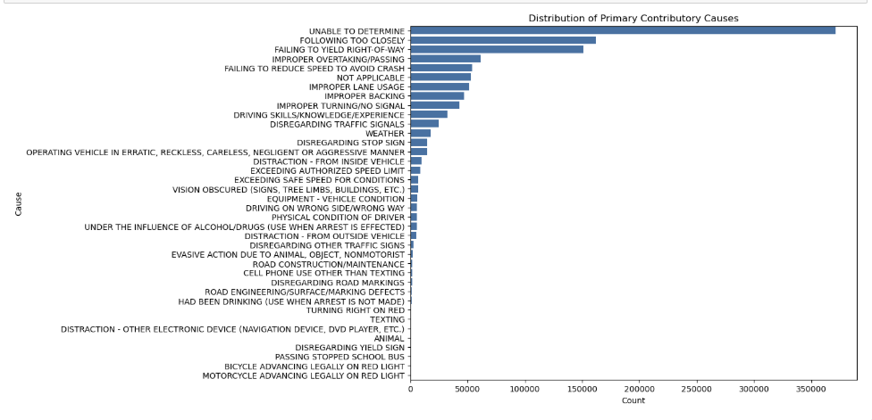
Data Analysis _Distribution of primary contributory causes
Below pareto shows Distribution of Primary Contributory Causes. As per the analysis “unable to determine “ was the leading in this deployment

Slide 7
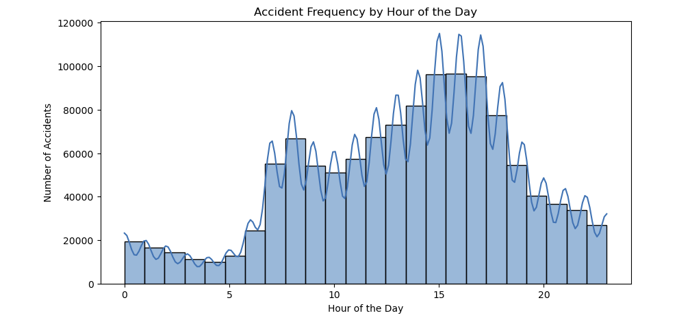
Data Analysis _ Hour of the Day
Accident Frequency by Hour of the Day. Below histograms shows the trend of accidents. Its evident that most accidents occurs in the afternoon hours

Slide 8
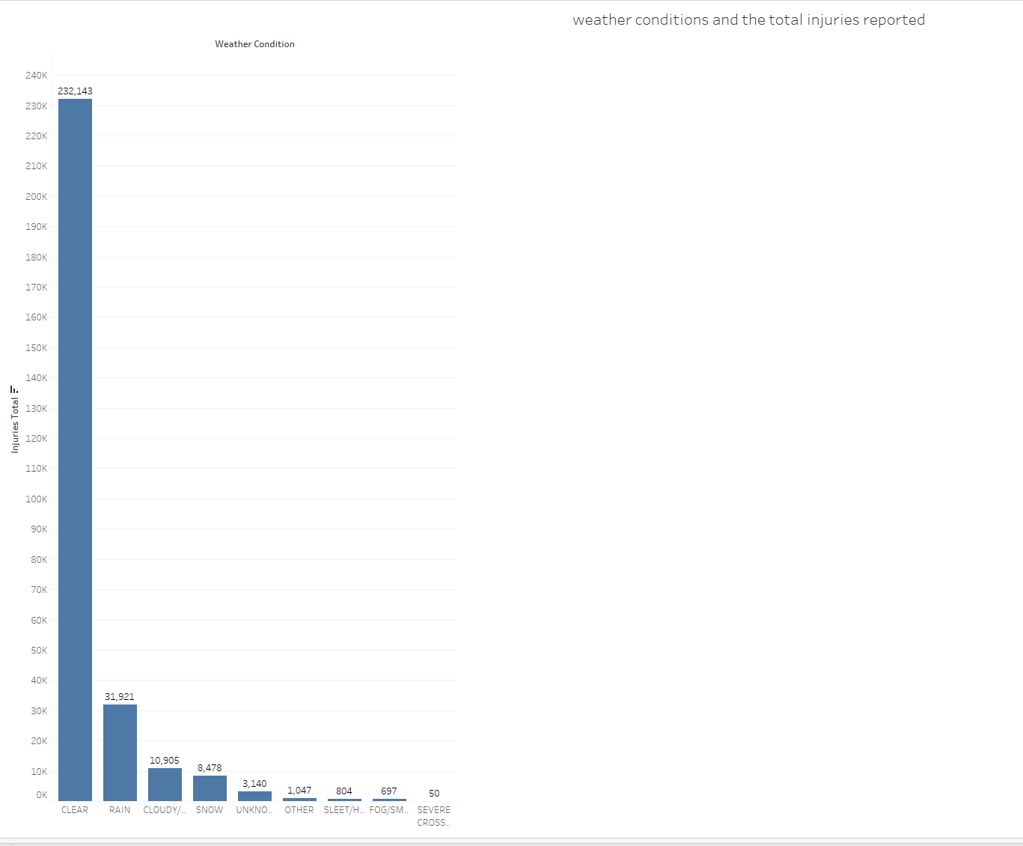
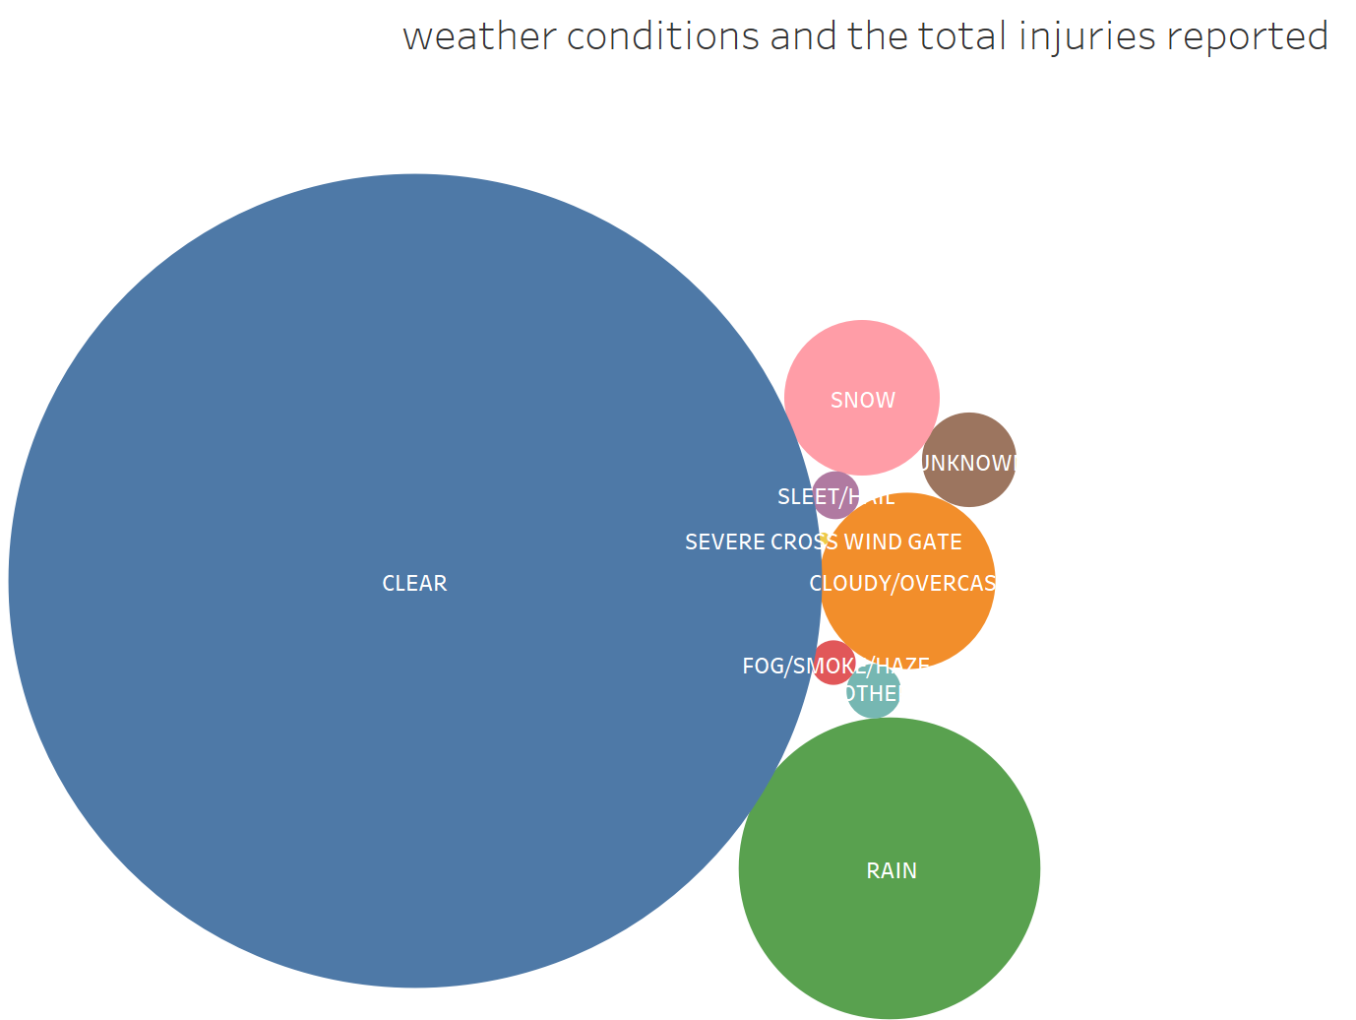
Analysis on Weather conditions
On examining the weather conditions and the number of reported injuries, it was noted that the most accidents occurred when the weather was very clear .

Slide 9
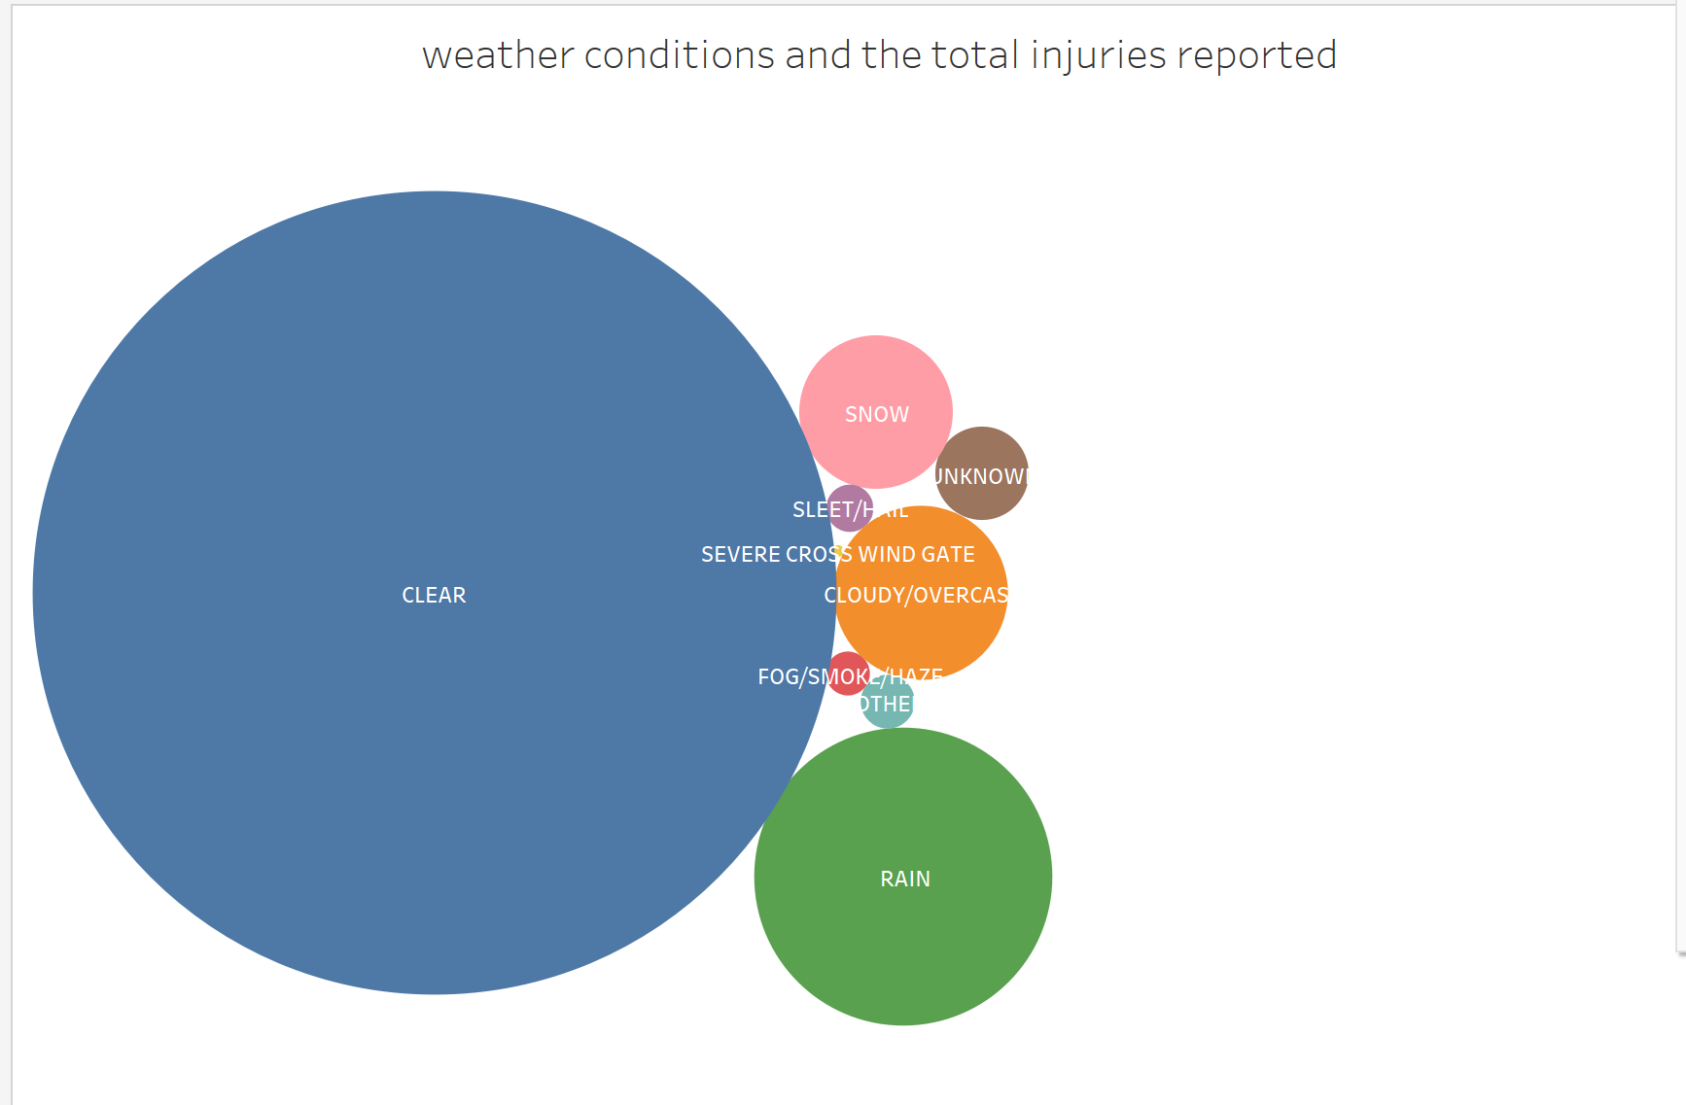
Data Analysis _ Gender and Accident Frequencies
Statistically, men drivers participate in a higher frequency of accidents compared to female drivers. This can be ascribed to increased risk-taking behavior, extended time spent on the road, and a heightened propensity for aggressive driving.
Female drivers, although participating in fewer accidents overall, exhibit a higher propensity for minor collisions, such as fender benders
Injuries Attributed to Gender: Men are more prone to participation in high-impact collisions, resulting in greater injuries and fatalities.
Females are more likely to incur injuries in collisions influenced by seatbelt usage and lower speed, resulting in distinct patterns of injury severity.

Slide 10
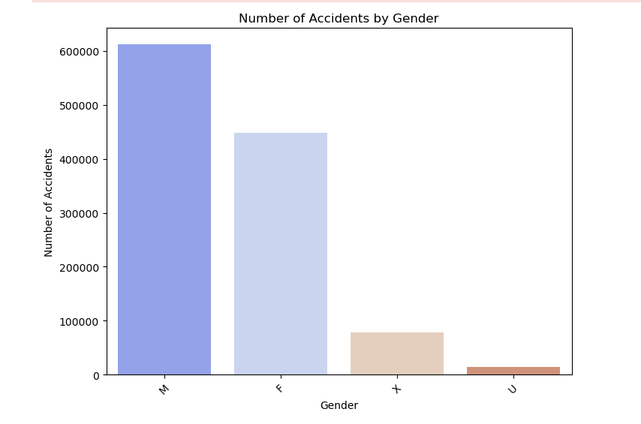
Data Analysis _ Gender and Accident Frequencies
.

Slide 11
Recommendation
Holidays and long weekends often record a surge in accident rates due to higher traffic volumes and impaired driving.
Winter months (December to February) also show a spike in accidents, particularly in regions experiencing snowfall and icy conditions.
October and November often see an increase due to shorter daylight hours and unpredictable weather changes.
As per the pareto “unable to determine “ was the leading cause of accident.
Most accident occurred 7-8am and a spike was seen from 10am to the peak at 3pm. 3pm to 5pm recorded highest number of accidents
It was interesting to see that most accidents occurred during clear weather , this implies that the drivers are more keen in harsh weather
Statistically, men drivers participate in a higher frequency of accidents compared to female drivers. This can be ascribed to increased risk-taking behavior, extended time spent on the road, and a heightened propensity for aggressive driving

